Slide 1
Nonlinear Optimization

Slide 2
Types of Optimization
There are 4 main types of optimization problems:
1. Linear Programming – objective function and
constraints are linear.
2. Integer Linear Programming – objective function and
constraints are linear but decision variables must be
integers.
3. Mixed Integer Linear Programming – same as ILP
with only some decision variables restricted to
integers.
4. Non-linear Programming – objective function and
constraints continuous but not all linear.

Slide 3
Types of Optimization
There are 4 main types of optimization problems:
1. Linear Programming – objective function and
constraints are linear.
2. Integer Linear Programming – objective function and
constraints are linear but decision variables must be
integers.
3. Mixed Integer Linear Programming – same as ILP
with only some decision variables restricted to
integers.
4. Non-linear Programming – objective function and
constraints continuous but not all linear.

Slide 4
Linear vs. Nonlinear
Examples of linear relationships:
𝑦 = 𝑎𝑥 + 𝑏 𝑧 = 𝑎𝑥 + 𝑏𝑦
Examples of nonlinear relationships:
𝑦 = 𝑎𝑥^{𝑏} 𝑧 = 𝑎𝑥𝑦

Slide 5
Algorithms
Nonlinear optimization is a lot harder of a process than linear optimization (careful of local optimum)
Many algorithms use gradients to solve the optimization.
Conjugate gradient method
Newton method with line search
Trust region
Genetic Algorithms

Slide 6
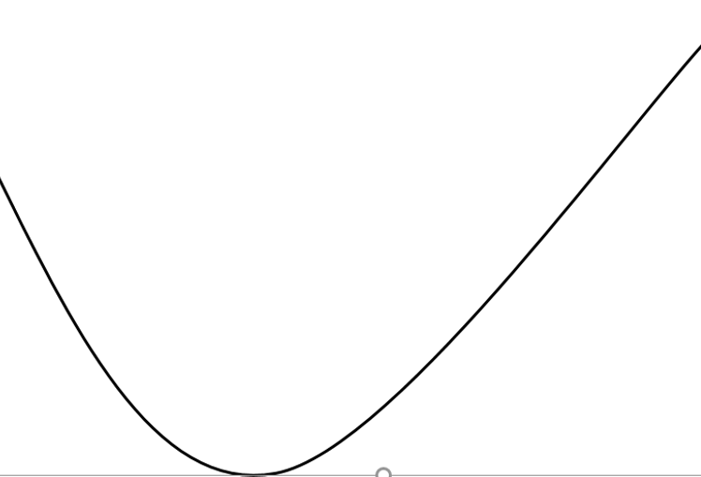
An example of Gradient Descent (minimizing a function)

Slide 7
An example of Gradient Descent (minimizing a function)

Slide 8
An example of Gradient Descent (minimizing a function)

Slide 9
An example of Gradient Descent (minimizing a function)

Slide 10
An example of Gradient Descent (minimizing a function)

Slide 11
An example of Gradient Descent (minimizing a function)

Slide 12
An example of Gradient Descent (minimizing a function)

Slide 13
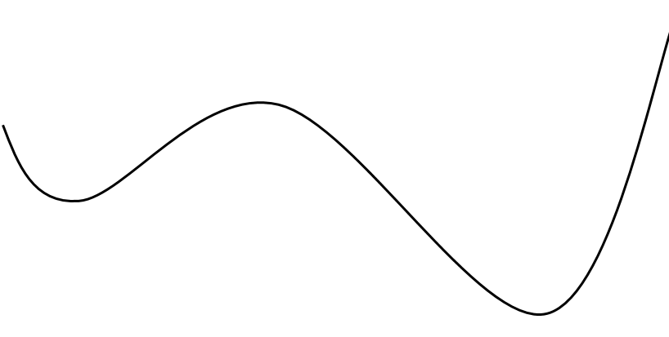
Potential issues
Local Minimum
Global Minimum

Slide 14
Multiple Answers
Depending on where we start determines our answer!
In cases with both local and global optima, there is no guarantee that a single run will produce the correct answer.
The best method is to try many different starting points to get an idea of how good our answer actually is.

Slide 15
Portfolio Optimization

Slide 16
Financial Portfolio
A portfolio is a collection of assets where the investor chooses the investment amount of each investment in the portfolio.
Portfolio performance is typically measured by total value of the portfolio at the end of a period of time.
To determine how much to allocate in each part of a portfolio, two things must be considered – risk and return.
Notes:
Use multiple points, if necessary.

Slide 17
Risk versus Return
Return –growth in the value of an asset (can also be percentage growth)
Risk – variability / volatility associated with the returns on the stock (can use standard deviation or variance)
We can look at historical data to estimate both risk and return.
Example: overall means and variance over a certain period of time (use historical data).
Notes:
Use brief bullets and discuss details verbally.

Slide 18
Optimizing a portfolio
When optimizing a portfolio, we focus on risk and return, therefore, we could either:
1. Minimize risk for a given return (typical)
2. Maximize return for a given risk

Slide 19
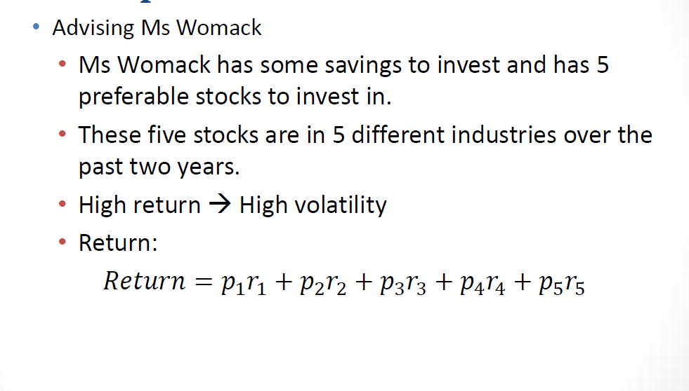
Portfolio Optimization Example

Slide 20
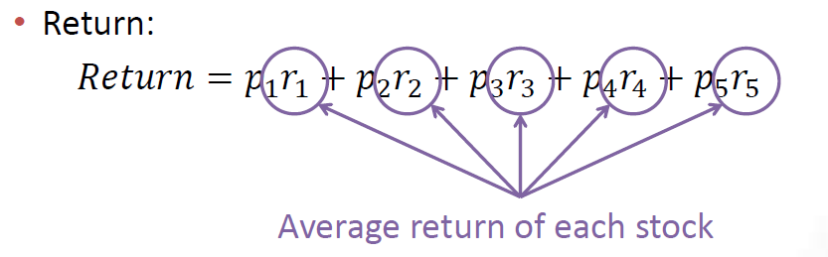
Portfolio Optimization Example

Slide 21
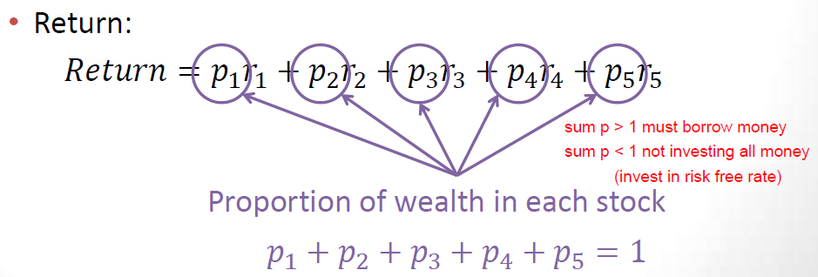
Portfolio Optimization Example

Slide 22
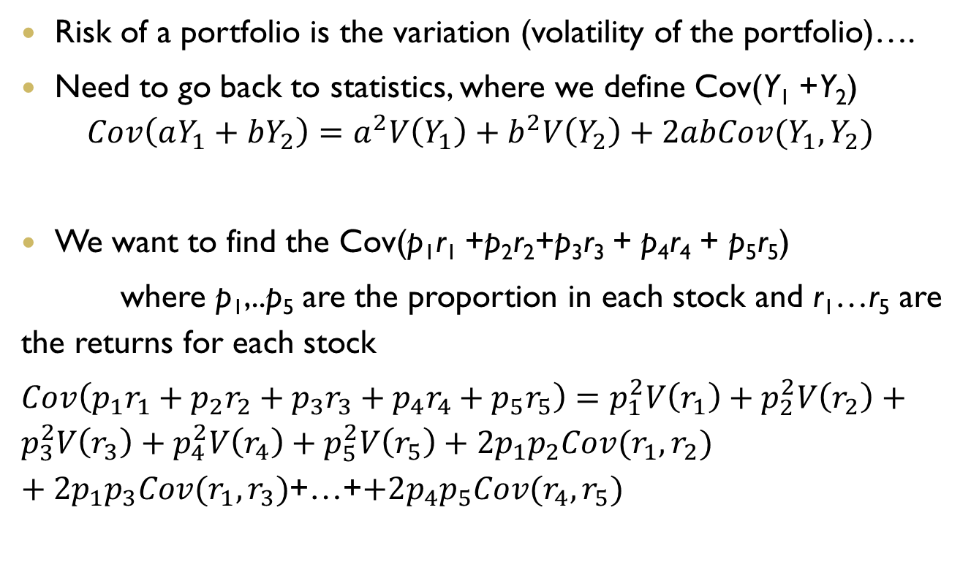
Risk of a portfolio
Risk of a portfolio is the variation (volatility of the portfolio)….
Need to go back to statistics, where we define Cov(Y₁ +Y₂)
$$Cov\left(aY_{1}+bY_{2}\right)=a^{2}V\left(Y_{1}\right)+b^{2}V\left(Y_{2}\right)+2abCov(Y_{1},Y_{2})$$
We want to find the Cov(p₁r₁ +p₂r₂+p₃r₃ + p₄r₄ + p₅r₅)
where p₁,..p₅ are the proportion in each stock and r₁…r₅ are the returns for each stock
$Cov\left(p_{1}r_{1}+p_{2}r_{2}+p_{3}r_{3}+p_{4}r_{4}+p_{5}r_{5}\right)=p_{1}^{2}V\left(r_{1}\right)+p_{2}^{2}V\left(r_{2}\right)+p_{3}^{2}V\left(r_{3}\right)+p_{4}^{2}V\left(r_{4}\right)+p_{5}^{2}V\left(r_{5}\right)+2p_{1}p_{2}Cov(r_{1},r_{2})$ $+2p_{1}p_{3}Cov(r_{1},r_{3})$+…+$+2p_{4}p_{5}Cov(r_{4},r_{5})$

Slide 23
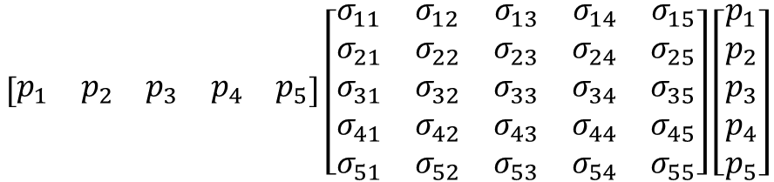
In Matrix form… (bet you thought you wouldn’t see this again….)
$$\left[\begin{matrix}p_{1} & p_{2} & p_{3} & p_{4} & p_{5}\end{matrix}\right]\left[\begin{matrix}σ_{11} & σ_{12} & σ_{13} & σ_{14} & σ_{15} \\ σ_{21} & σ_{22} & σ_{23} & σ_{24} & σ_{25} \\ σ_{31} & σ_{32} & σ_{33} & σ_{34} & σ_{35} \\ σ_{41} & σ_{42} & σ_{43} & σ_{44} & σ_{45} \\ σ_{51} & σ_{52} & σ_{53} & σ_{54} & σ_{55}\end{matrix}\right]\left[\begin{matrix}p_{1} \\ p_{2} \\ p_{3} \\ p_{4} \\ p_{5}\end{matrix}\right]$$

Slide 24
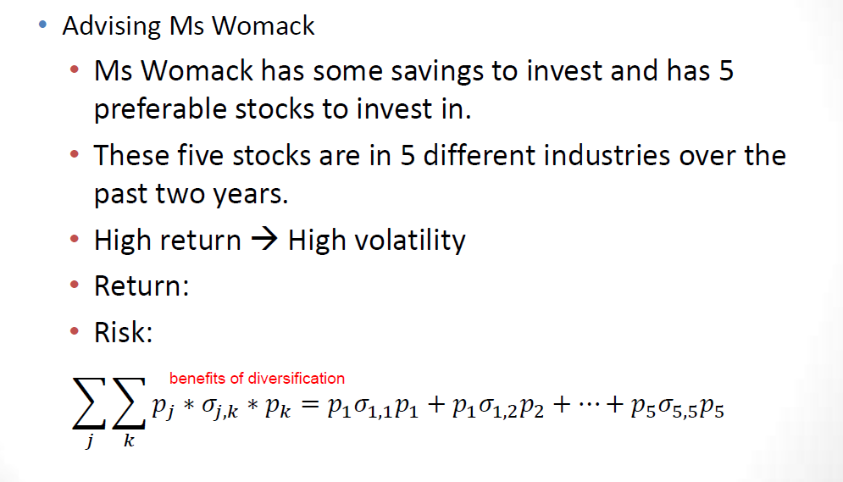
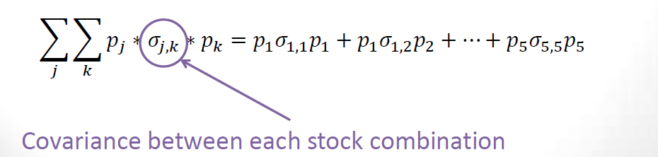
Portfolio Optimization Example

Slide 25
Portfolio data
data portfolio;
input Computer Chemical Power Auto Electronics;
cards;
0.22816 -0.07205 0.0173 0.22266 0.08202
0.09134 0.02588 0.05646 0.01278 -0.03499
-0.01288 -0.04771 0.0228 0.00379 0.01662
-0.17196 0.06343 0 0.04101 -0.07496
0.16557 0.0367 0.0051 0.07576 -0.0081
•••
;
2 years of monthly stock returns from these 5 stocks (i.e. 24 observations)

Slide 26
Creating data sets in SAS
proc corr data=portfolio cov out=Corr;
var Computer Chemical Power Auto Electronics;
run;
data Cov;
set Corr;
where _TYPE_='COV';
run;
data Mean;
set Corr;
where _TYPE_='MEAN';
run;

Slide 27
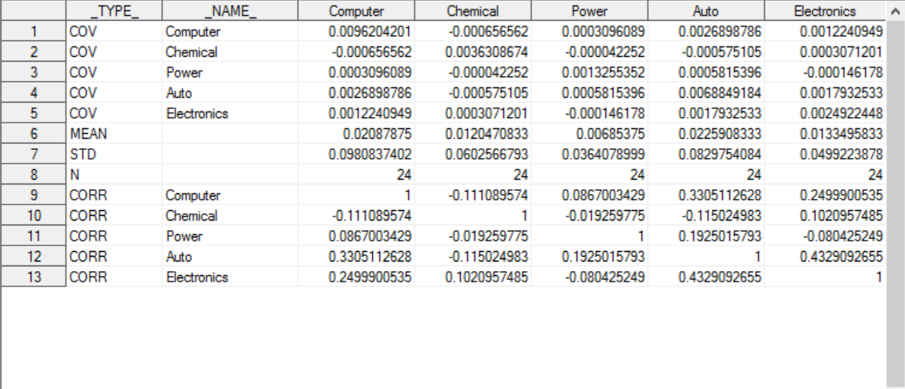
Corr data set

Slide 28
SAS Code
proc optmodel;
set <str> Assets1, Assets2, Assets3;
num Covariance{Assets1,Assets2};
num Mean{Assets1};
read data Cov into Assets1=[_NAME_];
read data Cov into Assets2=[_NAME_] {i in Assets1} <Covariance[i,_NAME_]=col(i)>;
read data Mean into Assets3=[_NAME_] {i in Assets1} <Mean[i]=col(i)>;
var Proportion{Assets1}>=0 init 0;
min Risk = sum{i in Assets1}(sum{j in Assets1}Proportion[i]*Covariance[i,j]*Proportion[j]);
con Return: 0.015 <= sum{i in Assets1}Proportion[i]*Mean[i];
con Sum: 1 = sum{i in Assets1}Proportion[i];
solve;
print Covariance Mean;
print Proportion 'Sum ='(sum{i in Assets1}Proportion[i]);
quit;

Slide 29
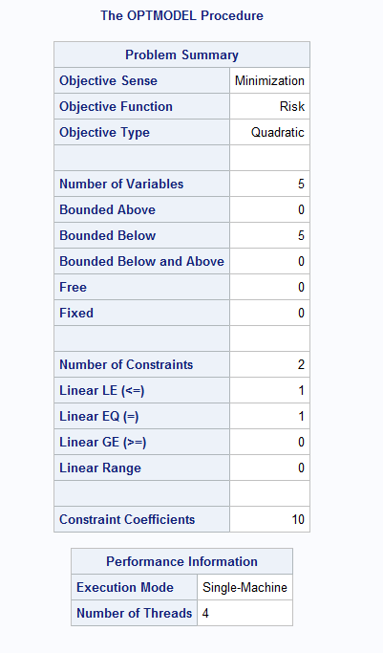
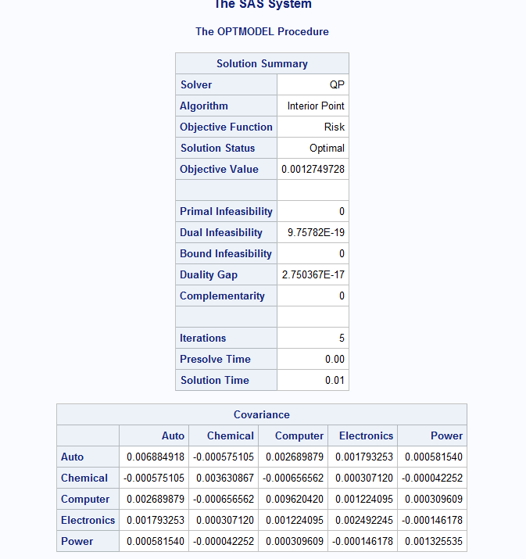

Slide 30
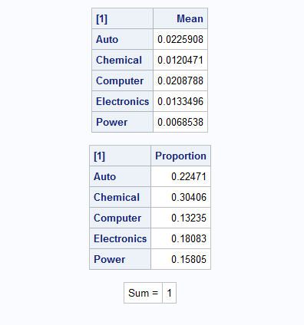

Slide 31
In R
setwd('C:/Users/Susan/Google Drive/Optimization')
port=read.table('portfolio_r.csv',sep=',',header=T)
mean.vec=apply(port,2,mean)
cov.vec=cov(port)
library(quadprog)
Dmat=cov.vec
dvec=rep(0,5)
Amat=t(matrix(c(1,1,1,1,1,mean.vec),nrow=2,byrow=T))
bvec=c(1,0.015)
meq=1
ln.model=solve.QP(Dmat,dvec,Amat,bvec,meq)
ln.names=c('Computer','Chemical','Power','Auto','Electronics')
names(ln.model$solution)=ln.names
ln.model$solution
ln.model$value

Slide 32
Output
> ln.model$solution
Computer Chemical Power Auto Electronics
0.1323478 0.3040609 0.1580473 0.2247138 0.1808302
> ln.model$value
[1] 0.0006374864

Slide 33
Efficient Frontier
Higher risk yields higher return. What is the best return we can achieve for a given level of risk (or what is the lowest risk for a given level of return)
The efficient frontier is the set of optimal portfolios that offers the highest expected return for a defined level of risk or the lowest risk for a given level of expected return. Portfolios that lie below the efficient frontier are sub-optimal, because they do not provide enough return for the level of risk. (Investopedia)

